Slide 1
Day 20
Kalman Filter

Slide 2
Plant or Process Model
describes how the system state changes as a function of time, control input, and noise
  state at time k
  control inputs at time k
  process noise at time k
  state transition model or matrix
  control-input model or matrix

Slide 3
Measurement Model
describes how sensor measurements vary as a function of the system state
  sensor measurement at time k
  sensor noise at time k
  observation model or matrix

Slide 4
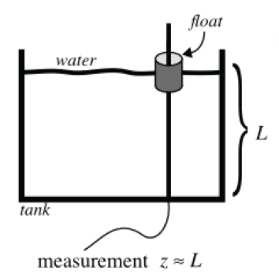
Tank of Water
estimate the level of water in the tank; the water could be
  static, filling, or emptying
  not sloshing or sloshing

Slide 5
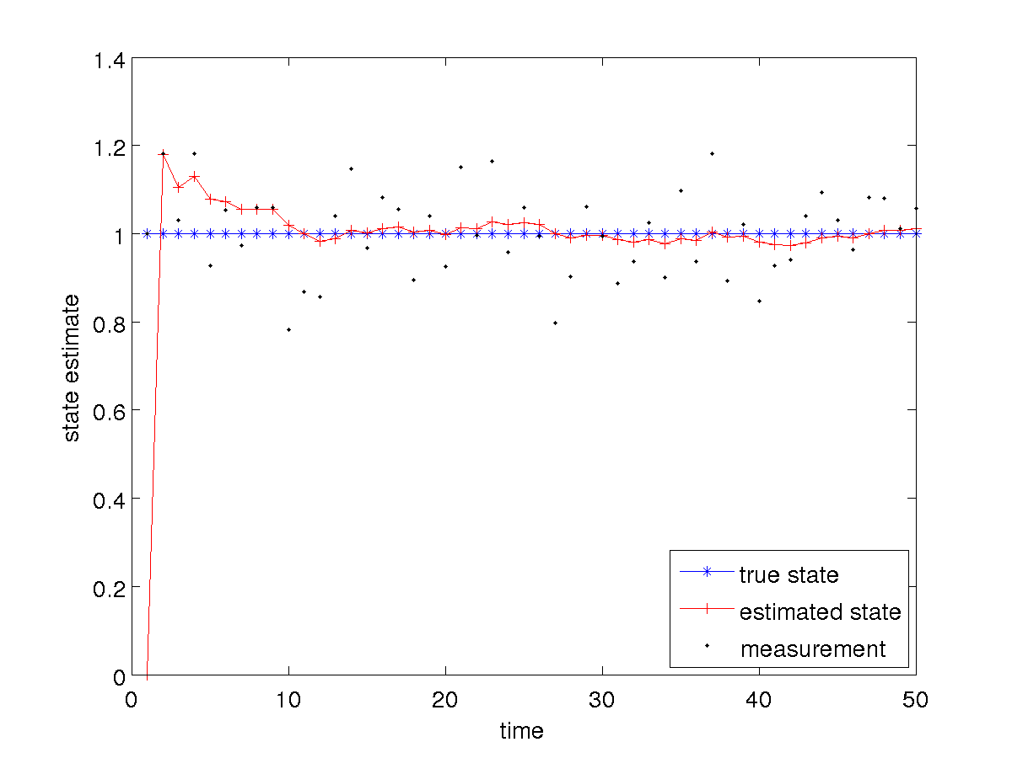
Tank of Water: Static and Not Sloshing

Slide 6
Tank of Water: Static and Not Sloshing
notice that in this case the Kalman filter tends towards estimating a constant level because the plant noise covariance is small compared to the measurement noise covariance
  the estimated state is much smoother than the measurements
what happens if we increase the plant noise covariance?

Slide 7
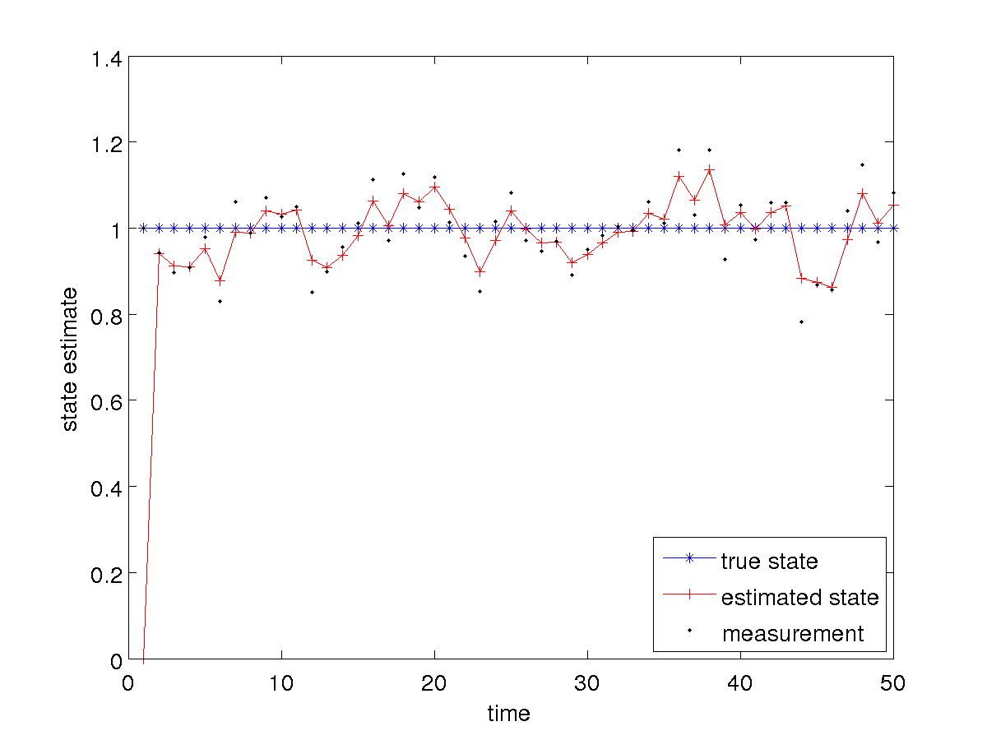
Tank of Water: Filling and Not Sloshing

Slide 8
Tank of Water: Static and Not Sloshing
notice that in this case the Kalman filter tends towards estimating values that are closer to the measurements
increasing the plant noise covariance causes the filter to place more weight on the measurements

Slide 9
Tank of Water: Filling and not Sloshing
suppose the true situation is that the tank is filling at a constant rate but we use the static tank plant model
  i.e., we have a plant model that does not accurately model the state transition

Slide 10
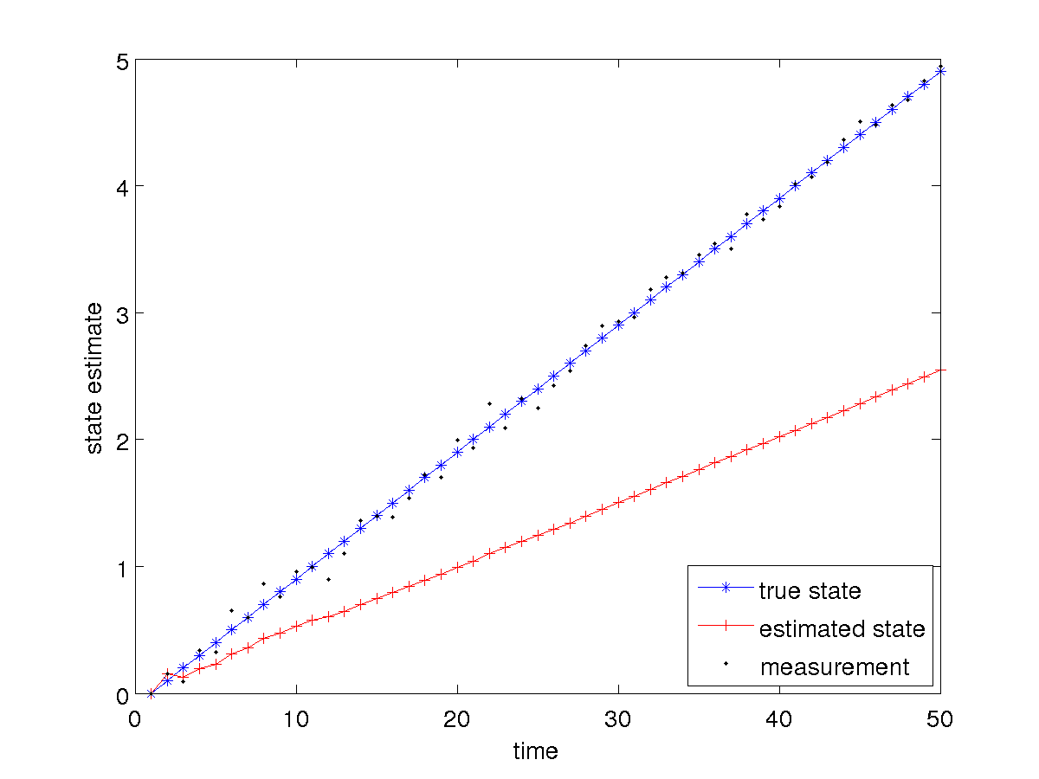
Tank of Water: Filling and not Sloshing

Slide 11
Tank of Water: Filling and not Sloshing
notice that in this case the estimated state trails behind the true level
  estimated state has a much greater error than the noisy measurements
if the plant model does not accurately model reality than you can expect poor results
  however, increasing the plant noise covariance will allow the filter to weight the measurements more heavily in the estimation…

Slide 12
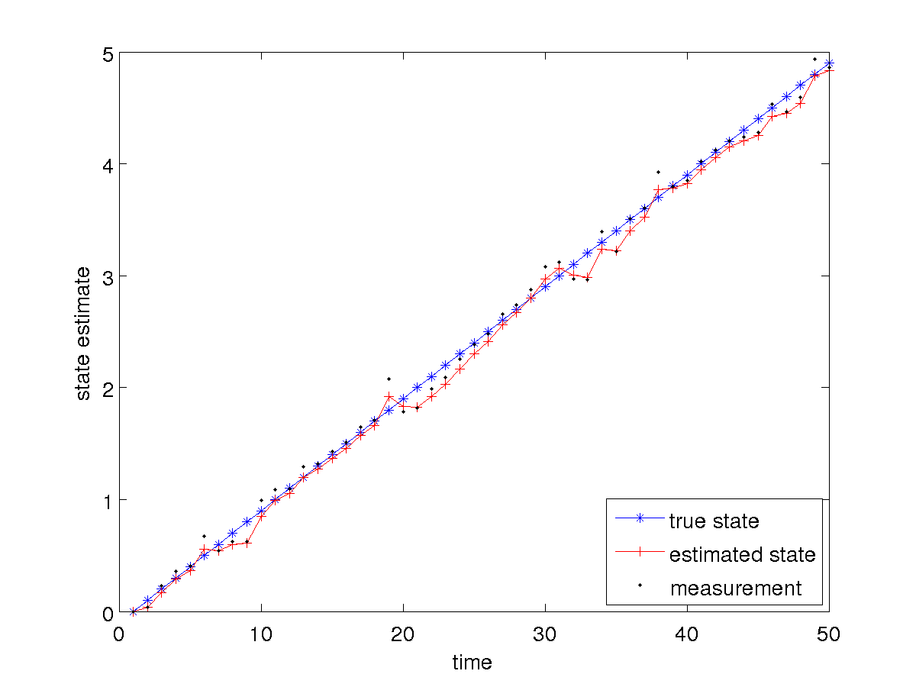
Tank of Water: Filling and not Sloshing

Slide 13
Tank of Water: Filling and not Sloshing
it is not clear if we have gained anything in this case
  the estimated state is reasonable but it is not clear if it is more accurate than the measurements
what happens if we change the plant model to more accurately reflect the filling?

Slide 14
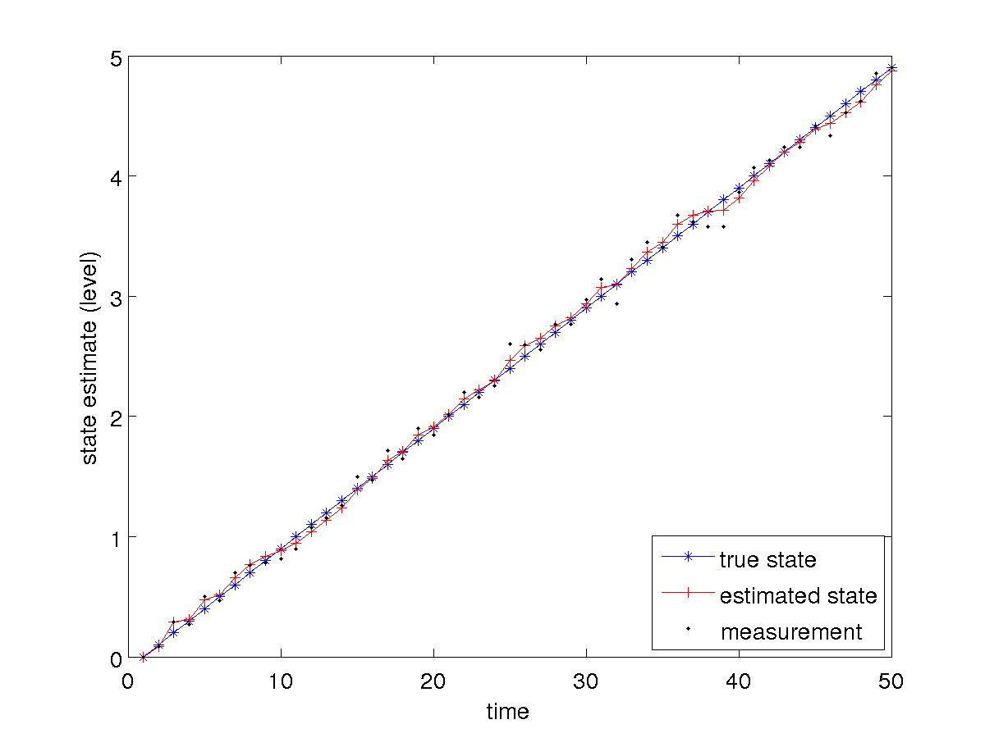
Tank of Water: Filling and not Sloshing

Slide 15
Tank of Water: Filling and not Sloshing
notice that the estimated state is more accurate and smoother than the measurements
what about the filling rate?

Slide 16
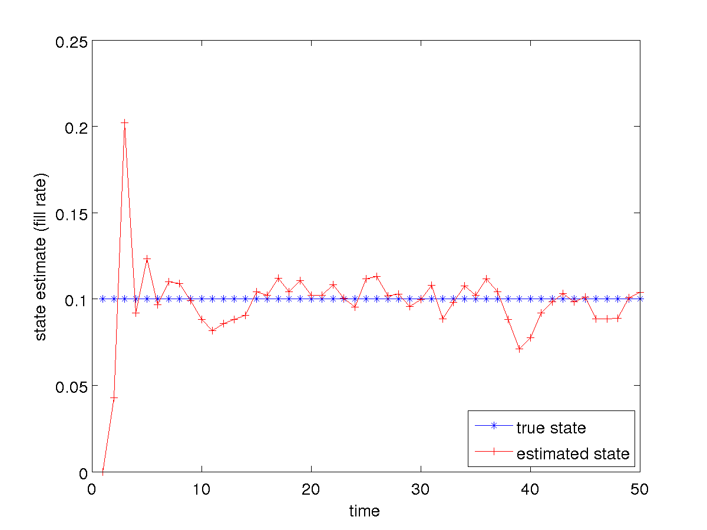
Tank of Water: Filling and not Sloshing

Slide 17
Tank of Water: Filling and not Sloshing
notice that the estimated filling rate seems to jump more than the estimated level
  this should not be surprising as we never actually measure the filling rate directly
    it is being inferred from the measured level (which is quite noisy)

Slide 18
Tank of Water: Static and not Sloshing
can we trick the filter by using the filling plant model when the level is static?
  hopefully not, as the filter should converge to a fill rate of zero!

Slide 19
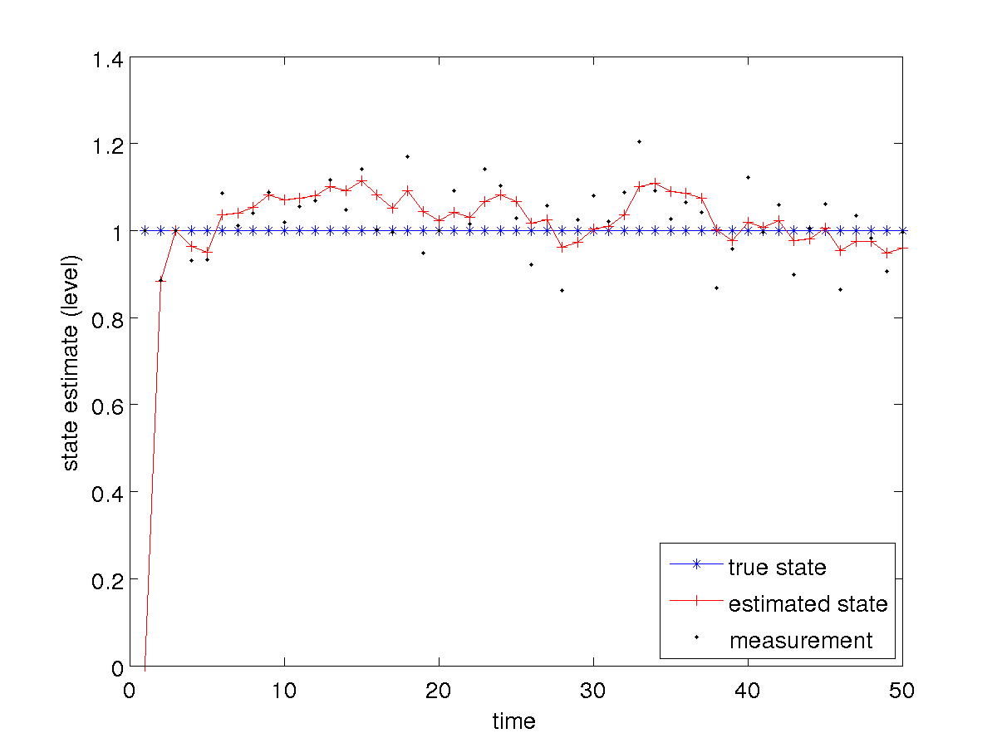
Tank of Water: Static and not Sloshing

Slide 20
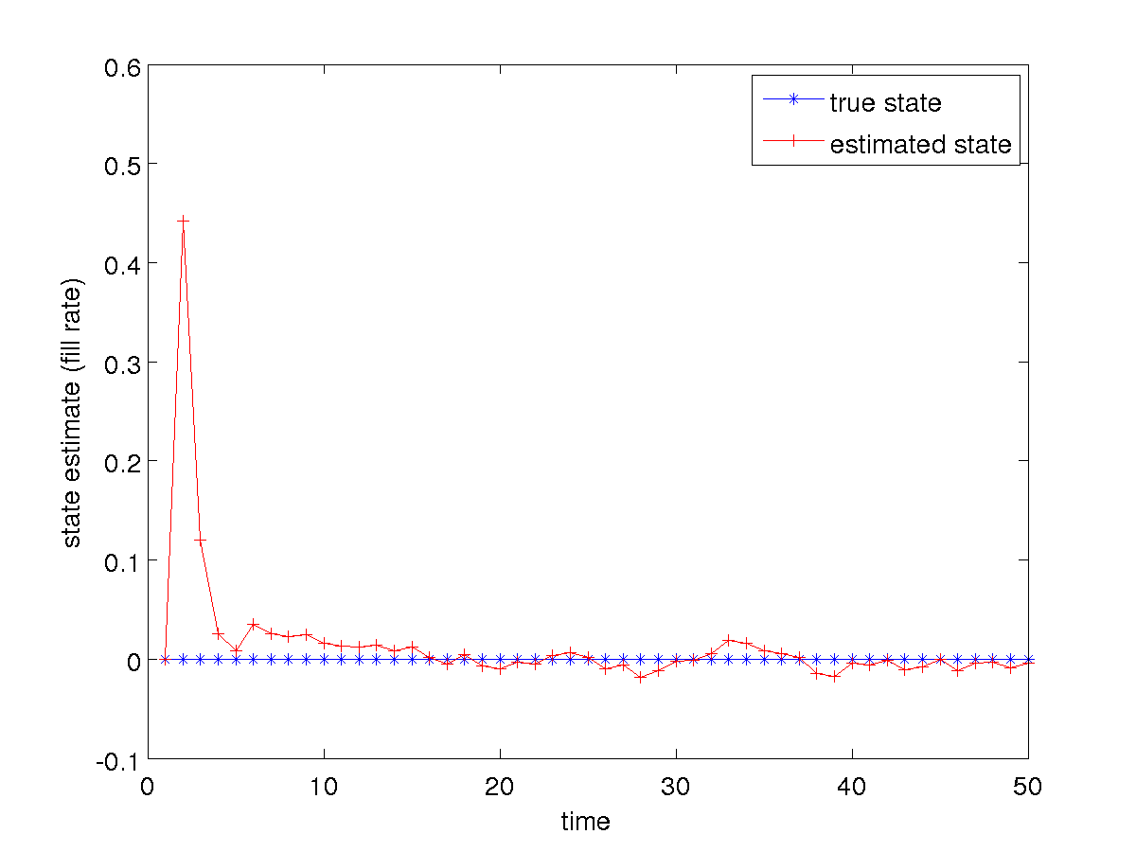
Tank of Water: Static and not Sloshing

